Slide 1


Recovery & Resilience Programme (RRP)

Slide 2


What have DTAS been doing?
Development of RRP has been driven by internal working group
Member engagement events – over 100 participated
Developing forms, guidance, processes and internal systems
Running a trial with six members to test processes and documentation
Recruiting two staff at DTAS to run the Programme

Slide 3
Key elements
On-track for Programme to open at the end of October
Open for two years
Grant funding will be available throughout that two-year period
Small grants up to £25,000
Large grants up to £100,000
£5 million provided to DTAS by Foundation Scotland

Slide 4
Funding & Support
Grant Funding
Up to £100,000 per member over lifetime of programme
Capital or revenue or a combination of two
Up to three applications per member
Direct Support
Access to specialist advice and support
One-to-one support from DTAS and other intermediaries
Training and resources

Slide 5
Pillars of Resilience
Purpose: Improved clarity and confidence in articulating and implementing the organisation’s purpose and strategic direction
Governance and Leadership: Strengthened leadership capacity, more effective governance practices, and enhanced decision-making processes
Finance, Funding and Enterprise: Income diversification, increased confidence in financial management, and a more enterprising approach
People and Operations: Improved skills, knowledge and wellbeing, internal procedures are better defined and utilised
Communications, Engagement and Impact: Stronger communication, improved community engagement and clearer articulation of impact through effective evaluation
Assets: Increased knowledge, confidence, and control in the effective management and development of physical assets

Slide 6
What can we apply for?
Flexible funding – must focus on your organisational recovery and resilience and align with the six pillars
Support with restructuring and strategic planning
Help to transition to a more sustainable business model
Improving financial sustainability, energy efficiency and reducing ongoing costs
Developing new income streams, raising finance and citizen investment
Communications strategies, impact measurement and social value
Improving your governance and leadership

Slide 7

What RRP will not fund
Activities or projects which do not aim to achieve at least one of the six programme outcomes
Feasibility studies where there is not a direct link to at least one of the six programme outcomes
Place Plans or Community Action Plans
Repayment of loans or debt payment
VAT costs that can be recovered
Retrospective funding
Salary costs that do not meet or exceed the Living Wage

Slide 8
Trial feedback
Six Members completed Self-Assessments
Four submitted Full Applications
Two felt the timing wasn’t right to apply
Three were awarded funding
One was unsuccessful
Feedback from trial is informing changes to processes and documentation

Slide 9
Applying for Funding
Stage 1
Self-Assessment
Complete an online self-assessment form
This helps your board and staff identify your organisation’s current strengths and areas for development. Includes a short summary of what you are proposing to achieve
Self-assessment review
DTAS will review your self-assessment and identify where you need support. DTAS will check that your funding proposal is aligned with this need.
Tailored direct support
Based on your self-assessment review, you may be offered direct support or advice to strengthen your foundations - alongside or instead of grant funding

Slide 10
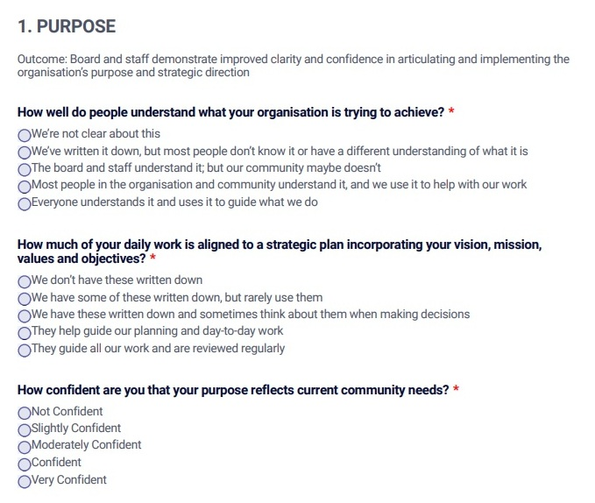
Self-Assessment Form

Slide 11
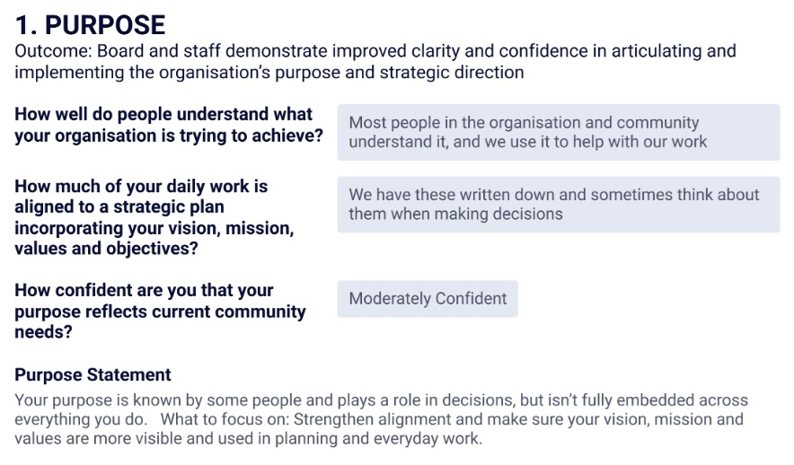
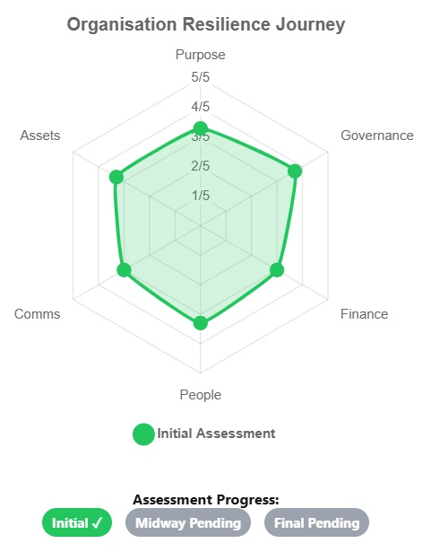
Self-Assessment Results
Extract from document providing feedback on a Self-Assessment
Radar Chart showing scores

Slide 12
Applying for Funding
Stage 2
Full Application
Complete an online application for grant funding
Based on your self- assessment review, you may be invited to submit an online application. The application will ask you to provide more detail on your proposal
Application assessment
Your application will be reviewed by a panel. You may be asked for additional supporting information.
Notification
You will be notified of the panel’s decision. If successful, you will receive a grant award. If you are not successful, you will receive feedback and may be offered support to reapply.

Slide 13
How will DTAS make decisions?
Small Grants (Up to £25K)
Internal DTAS Panel
Minimum five people
Large Grants (Over £25K)
Internal DTAS plus external
Minimum five people
Meets monthly
Meets quarterly
Panel decision making criteria
Level of organisational need
Contribution of the proposal towards the six resilience outcomes
Deliverability of the project and level of risk
Value for money

Slide 14
Key points to remember
The fund is focussed on improving the resilience of your organisation
Employing a Development Officer to deliver projects that are good for your community but don’t improve your organisations resilience will not be supported by this Programme
You can apply up to three times over the lifetime of the Programme – so don’t try to include everything you want to do into one application, think about whether a small grant could help prepare the ground for larger application
We expect the fund to be competitive, so really think about how much funding you actually need before applying
This is a rolling programme, DTAS will ensure that funding is available throughout the two years, so apply when you are ready
This Programme is about more than money, so speak to DTAS about what it is you need to make you more resilient, as we or others may be able to support you with this directly

Slide 15
Key Dates
27th October RRP opens
First Small Grants Panel (December)
First Large Grants Panel (February 2026)

Slide 16
How do I find out more?
Visit the website:
All information about RRP can be found in the members area of the DTAS website. This will include the Self-Assessment form, once the Programme opens: https://dtascot.org.uk/members-area-page/login/
If you are having trouble logging in, please contact: membership@dtascot.org.uk
Contact the team:
Gaby Nolan - Recovery & Resilience Programme Grants Officer – can help with general enquiries as well as support with technical queries around completing your Self-Assessment or Full Application Form - gaby@dtascot.org.uk
Errin Anderson – Recovery and Resilience Lead – can help with access to direct support – such as advice, training and resources, as well as guidance on refining your application and ensuring alignment with the Programme outcomes – errin@dtascot.org.uk

Slide 17

Questions?
This Photo by Unknown Author is licensed under CC BY-SA-NC

