Slide 1


Slide 2

What is BVT?
  Company limited by guarantee
  Registered charity
What does it aim to do?
  Sustainability
  Community development
  Education & health
  To fund other local people to do the same
How does it work?
  Board of Directors and sub-groups all made up of volunteers

Slide 3
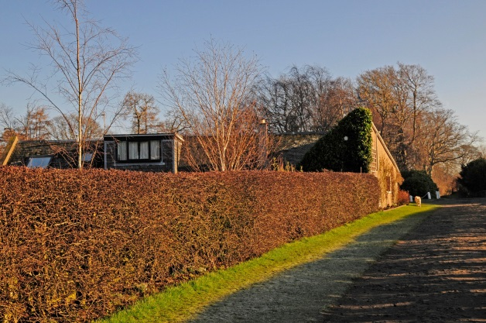

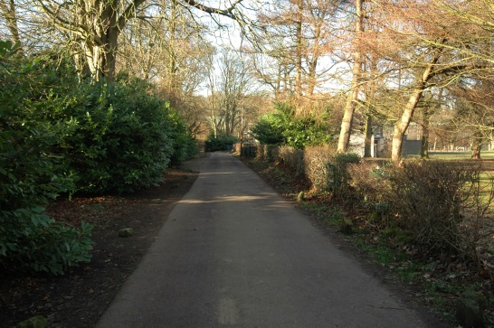

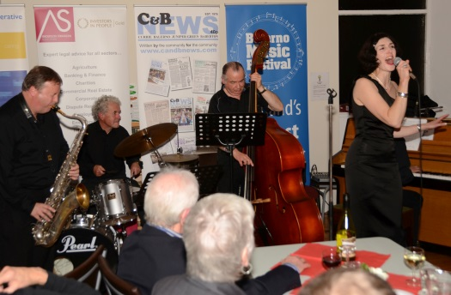
What’s it done and what’s it doing?
  Farmers Market, Founding partner in Balerno Music Festival, Sustain Balerno (Tattie day, Apple Day, Community Orchard, Bee Hives etc etc etc), Ravelrig Walled Garden, Hydro, partner in Balerno Christmas ……….
What does it aim to do?
  Develop and deliver new ideas and projects
  Help other groups to develop ideas and projects which are consistent with BVT’s charitable purposes
How will it do all that?
  Income from projects
  Grants to community bodies via a broad based grants committee

Slide 4
To Dream a Dream
To develop the microhydro resource at Harlaw Reservoir as an income stream for the BVT
To encourage as many local people as possible to get involved
To use the funds to seedcorn other social, economic and renewable developments within the area.

Slide 5
We were inspired by
Visits to Fintry and Comrie for CCF funded events.
Sustain Dunbar and PEDAL
Visits to Mull and Twechar as part of DTAS supported leadership course.
Phone call to Udny Development Trust.
The websites of many Development Trusts.
The pioneering communities on the CES website.
Torrs Hydro- they have already done it!!
Jim Baker’s presentation on community shares at a DTAS conference 3 years ago.
Sheffield Renewables presentation on IPS Ben Comms.
WE SALUTE YOU ALL

Slide 6
Presentation Structure
Community shares - introduction
Stages in the development process
Legal structures
Designing and making a share offer
Case study Harlaw Hydro
Conclusions and discussion
Dave Hollings of Co-operative and Mutual Solutions Limited- BVT Shares Training workshop

Slide 7
Business development and planning
Is there a viable business? An asset to develop?
What finances are needed to make a viable business?
What sources are there for this finance? At what cost?
Are there any troops? How strong is community support?
How will the business be managed?

Slide 8
Raising Finance/funding
Development of business plan and indicative financial forecasts with sources of finance/funding:
  Community shares – Yes. Based on previous examples, aiming for 50% of the funds needed.
  Grants - return for time taken to apply not persuasive. State Aid Rules.
  Loans- likely sources explored. Expensive- interest of between 7-10%. Risk assessment and due diligence.
  Spreading investment over time – negotiate favourable heads of terms with CEC re lease payments. Long term lease (50 years +)

Slide 9
Legal and Governance
What legal structures are available?
  Company Limited by Guarantee
  Community Interest Company
  Industrial and Provident Society
What governance arrangements?
  Who will be the members?
  Who will be the board
  How will the board be accountable to the community?

Slide 10
Companies - Pluses
Corporate status
Limited liability for members
Very flexible
Familiar legal form (but Guarantee Companies less familiar)
Usual form in the third sector
Can provide equity in the share form

Slide 11
Companies - Minuses
Not designed for social enterprises
The guarantee form is unfamiliar in the business sector
The share form is difficult to reconcile with social enterprise principles (except in a CIC)
No regulation of social purpose
Proxy voting as of right (threat to initial purpose)

Slide 12
Community Interest Company
Organisational form specifically for social enterprises:-
  Must have a community interest statement
  Non-profit-distribution through an asset lock
  Intended to make both charitable and commercial funding more accessible
  Establish a clear social enterprise 'brand'
Regulated by the CIC regulator
CICs can be limited by guarantee or shares

Slide 13
Community Interest Companies - Pluses
Specifically designed for social enterprises
All the freedoms and flexibilities of a normal company
The social purpose is regulated
Can provide equity with shares always at face value (par) and a cap on dividend

Slide 14
Community Interest Companies - Minuses
Bolting on social purposes to company structure
Shares in CICs are normally one share one vote
No exemptions from the Financial Services and Markets Act
More regulation

Slide 15
Industrial and Provident Society
Incorporated organisations
Regulated by Financial Services Authority (FSA)
Designed specifically for co-operatives and community benefit organisations
Co-operatives are run for mutual member benefit
Societies for the benefit of the community (bencoms) are run for the benefit of a wider community than the members
Limited by shares – but different from company shares
Exemptions from Financial Services and Markets Acts

Slide 16
Industrial and Provident Societies - pluses
Provide corporate status
Limited liability for members
Designed for social enterprises
One member one vote enshrined
Some regulation of social purposes
Can provide equity always at face value (par) and which can be with drawable

Slide 17
Industrial and Provident Societies - minuses
Unfamiliar legal form
Legislation lags behind that for companies
Cost of registration can be much higher (although this actually only cost us £50)

Slide 18
Industrial and Provident Society shares compared with Company shares
Societies have major advantages over companies for community share issues:
A company share issue must be approved by an authorised investment advisor. A society share issue does not.
A company share issue means forming a plc which is more heavily regulated.
Company shares mean one share one vote. Society shares mean one member one vote.
Society shares are easily withdrawable. Company shares are not.

Slide 19
A Note on Bonds
A community bond issue is not the same as a community share issue:
A bond is a form of loan
A legal agreement between the issuer of the bond and the purchaser which usually states the amount of interest to be paid on set dates and when the loan will be repaid in full.
Bonds must be repaid by a fixed date, so profits must be set aside to fund these repayments.
Bonds give no right to membership or ownership

Slide 20
Unique features of IPS withdrawable share capital
Withdrawable and/or transferable. Sold back to HH.
One member, one vote democracy
Flexible cap on returns. Defined benefit for shareholders.
Withdrawable shares exempt from financial promotions regulations

Slide 21
Marketing and Promotion
Necessary to prepare business plan and offer documents (we had support from Dave Hollings for this)
Define community and start building a “register of interest” as soon as possible
Establish a web presence and e-mail communications with interested parties
Arrange public meeting(s)

Slide 22
Case Study – Harlaw Hydro

Slide 23
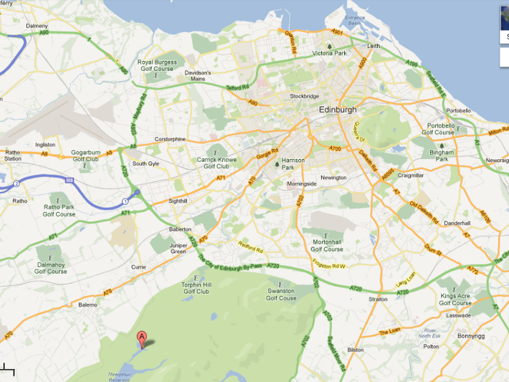
Edinburgh
Harlaw Hydro

Slide 24
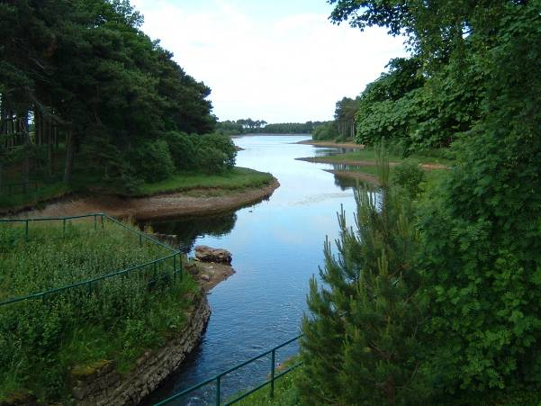
OBJECTIVE
To raise £313,000 through a share offering, low interest loans and gift aid to fund a community hydro scheme at Harlaw Reservoir

Slide 25
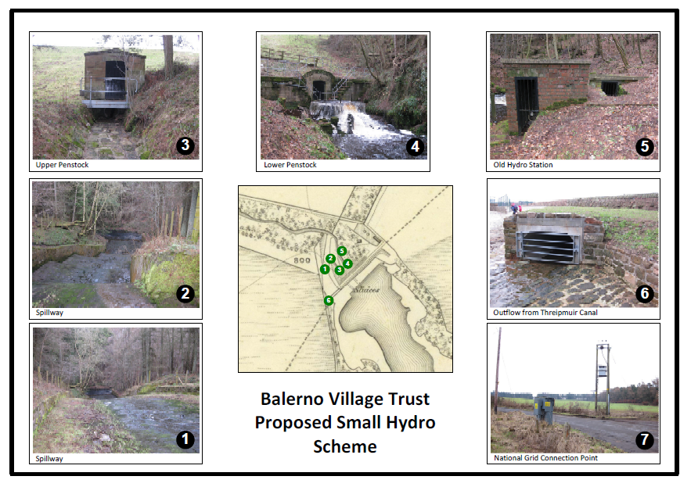

Slide 26
Numerical Summary
Size of system | Units pa (kwh) | CO2 Saved | Homes | Cost | Annual Revenue
65KW | 260,000 | 129 tonnes | 56 UK average | £313,000 | £58,000
source Highland Eco Feasibility Study 2011 (funded by Community Energy Scotland)

Slide 27
Why do this?
To generate ‘green’ hydro-electricity and feed it into the Grid.
Commercial viability due to the Feed in Tariff (FiT)
  Currently the Government will pay 20.21p per kwh on top of the standard commercial payment of 3.2p per kwh
To provide support for community projects and activities.

Slide 28
How can we have income reassurance?
HMG guarantees FiT rates for 20 years from the start of electricity generation
Secure Preliminary Accreditation
  From 1 December 2012, prospective installations which fall into the “ROO-FIT” application pathway (less than 5MW) are able to apply for preliminary accreditation. This mechanism provides a tariff guarantee provided generation starts within 2 years.
We needed to line up 4 ‘ ducks’ to apply for this

Slide 29

The 4 Rubber Ducks to line up
Planning Permission Granted October 2012
Extraction License Granted by SEPA October 2012
Lease agreement Heads of terms approved by CEC March 2013
Grid Connection G59 submitted to Scottish Power March 2013 Connection offer May 2013. Accepted June 2013

Slide 30





Community Energy Scotland
Provided the grants for the feasibility studies
Provided advice and contacts and have always had a Development Officer at our meetings.
Connected the project with David Hollings of Co-operative and Mutual Solutions Limited

Slide 31
Harlaw Hydro Ltd
An Industrial and Provident Society, created for the Benefit of the Community
Can sell shares to raise capital
Is a cooperative society owned by its members
Has the specific purpose of owning and operating a micro-Hydro scheme
Membership of Harlaw Hydro Ltd is open to individuals, corporate bodies, voluntary organisations and public sector investors.

Slide 32
What structure would work best?
The hard questions:
Could BVT create HH as a wholly owned subsidiary/trading arm?
We investigated sources of loan finance. BVT has no assets (apart from some market stalls!). The renewable energy scheme is too small to be worth the due diligence for commercial banks , even the Co-op Bank and Triodos.
We could have applied to the CARES Loan fund but this would have been a very expensive option at 10% interest.

Slide 33
What about a Golden Share?
Could the BVT not create a CIC and maintain a controlling share?
We would need to buy in legal help and we would need to use an authorised investment advisor. To do this we would need to access loan finance from CARES (at 10% interest)

Slide 34
“I don’t want a Co-op!”
People were worried that we would have spent so long working on this only to choose a finance vehicle that didn’t work:
“What if no-one buys any shares?”
“What if the shareholders decide to take the money away from the BVT?”

Slide 35
A Robust Set of Transparent Rules
With advise from Dave Hollings of CMS Co-op Dev we arrived at a set of rules for the IPS Ben Comm with key features :
Defined benefit – initially set at 4% - for shareholders
Up to 3 of the 9 HH Directors must be from BVT
The payment of any profits after costs to the BVT to use in accordance with it’s charitable purposes (to change this would take more than 50% of the membership to vote for an amendment at an AGM)

Slide 36
Funding the Project – Plan A
Our Initial Plan:
Funding would be sought from several sources:-
Through shares in Harlaw Hydro Limited
Through donations and Gift Aid to Balerno Village Trust expressly for this purpose
Through interest-free loans
Through a commercial loan to cover the short fall
HAPPILY, WE RAISED THE LOT (AND SOME) £335,250

Slide 37
Commercial Loan Options
Co-op and Community Finance
  £150K @ 6% interest + 1% arrangement fee (includes due diligence)
Renewable Energy Investment Fund via Scottish Investment Bank
  £150K @ 8% interest
Geocapita – private investment company. Working with Scottish Government to make loans for community energy developments.

Slide 38
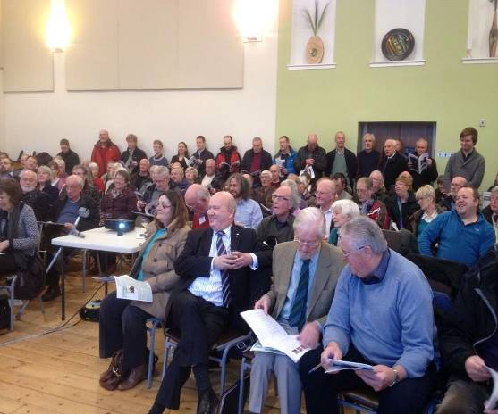
Finally ….We launched
” I wondered what big event we had unwittingly managed to clash with and then I had to queue to get in to the hall, which was standing room only“
Something had definitely shifted…

Slide 40
  The Harlaw Hydro Share Offer
Each share has a nominal value of £50.
The minimum shareholding is £250.
Shares have to remain invested for at least 3 years (plus 3 months) after Harlaw Hydro Ltd starts trading (selling power).
Shares in Harlaw Hydro Ltd are not transferable in the way that shares in, say, British Gas are, they are termed as ‘withdrawable’ shares - only the issuer, Harlaw Hydro Ltd, can buy them.
Share offer 9th April to 28th June 2013

Slide 41
Level of Interest to Shareholders
The level of interest will be set by the board of Harlaw Hydro annually.
  The maximum level of interest is limited to 2% over the Co-operative Bank’s base rate or 5%, whichever is the higher.
  The financial projection assumes 4%

Slide 42
Financial Projection
Year | Income | Maint. & Serv. | Share Interest | Loan Payments | Cost of Lease | Oper. Costs | Oper. Surplus | Available to BVT | Capital Reserve
 | A | B | C | D | E | F | G | H | I
 |  |  |  |  |  | B+C+D+E | A-F |  | G-H
1 | £29,000 | £3,452 | £0 | £24,292 | £0 | £27,744 | £1,256 | £0 | £1,256
2 | £59,450 | £3,590 | £6,000 | £24,292 | £0 | £33,882 | £25,568 | £5,000 | £20,568
3 | £60,936 | £3,734 | £6,000 | £24,292 | £0 | £34,025 | £26,911 | £10,000 | £16,911
4 | £62,460 | £3,883 | £6,000 | £24,292 | £0 | £34,175 | £28,285 | £15,000 | £13,285
5 | £64,021 | £4,038 | £6,000 | £24,292 | £0 | £34,330 | £29,691 | £20,000 | £9,691
6 | £65,622 | £4,200 | £6,000 | £24,292 | £0 | £34,492 | £31,130 | £25,000 | £6,130
7 | £67,262 | £4,368 | £6,000 | £24,292 | £1,304 | £35,964 | £31,298 | £30,000 | £1,298
8 | £68,944 | £4,543 | £6,000 | £24,292 | £1,364 | £36,199 | £32,745 | £30,000 | £2,745
9 | £70,667 | £4,724 | £6,000 | £24,292 | £1,426 | £36,442 | £34,225 | £30,000 | £4,225
10 | £72,434 | £4,913 | £6,000 | £24,292 | £1,489 | £36,694 | £35,740 | £35,000 | £740
11 | £74,245 | £5,110 | £6,000 | £0 | £2,525 | £13,635 | £60,610 | £55,000 | £5,610
12 | £76,101 | £5,314 | £6,000 | £0 | £2,591 | £13,906 | £62,195 | £55,000 | £7,195
13 | £78,004 | £5,527 | £6,000 | £0 | £2,659 | £14,186 | £63,818 | £55,000 | £8,818
14 | £79,954 | £5,748 | £6,000 | £0 | £2,728 | £14,476 | £65,478 | £55,000 | £10,478
15 | £81,952 | £5,978 | £6,000 | £0 | £2,799 | £14,777 | £67,176 | £60,000 | £7,176

Slide 43
Why Did people Invest?
Feel Good – a social investment
  Provide Funds for community projects and activities
  Green Energy
Financial
  4% interest compares favourably with Savings Accounts and cash ISAs
  50% tax relief through the Seed Enterprise Investment Scheme and 30% through Enterprise Investment Scheme was the final push for people.
  “This is a no brainer”

Slide 44
SEIS Example
Jenny invests £20,000 in the tax year 2012-13 (6 April 2012 to 5 April 2013) in SEIS qualifying shares.
The SEIS relief available is £10,000 (£20,000 at 50%).
Jenny’s tax liability for the year before SEIS relief is £15,000 which she can reduce to £5,000 (£15,000 less £10,000) as a result of her investment.
Source HMRC website

Slide 45
Who are our investors?
232 investors in total:
Average size of investment - £1,588
Most Common - £500 0r £1000
Maximum £9,750 (min £250)
Just over half from immediate Balerno area
20% from surrounding area
20% from wider Edinburgh Area
10% anywhere else

Slide 47
What have we spent to get here?
From BVT Annual account March 2012, HH spent £600
From March 2012 to now HH has spent a further £3100 of BVT funds
These BVT funds are the profits from the monthly Balerno Farmers Market
Included in the £3100, is £1500 which we spent on the Community Share Offer.
TOTAL £3,700 to date.
Other creditors are due £2,100 in negotiated deferred payment until we start trading.

Slide 48
Now that we have the money…..
We need to change our thinking – we need to get paid managers in and become overseers.
We’ve done everything ourselves on a shoe string; we need to change that and spend wisely.
We need to expand the HH interim board to full capacity as soon as possible.
We need to work closely with the BVT Board to publicise a set of grant criteria rules to keep the spending of the money as transparent as possible.
We need to keep an eye on Communication, now that we are sitting on peoples’ money.

Slide 49
“If communities - all over the country, not just those on windy hills - are to be empowered, the only game in town is equitable access to a share in the wealth of renewables, (and not just wind). These are big themes that need powerful thinking, and a willingness to reach into the deeper structures of ownership of our land and natural resources; the time is now.”
Pauline Gallacher NDT on the occasion of the opening of Neilston Community Windfarm

