Slide 1
Funding Local Assets
Neil Ritch
Alastair Jackson
Notes:
Updated July 2019 AJ

Slide 2
Funding Local Assets
Where we are now
What next?
Notes:
*2018/2019 financial year figures

Slide 3
Some background
Notes:
*2018/2019 financial year figures

Slide 4
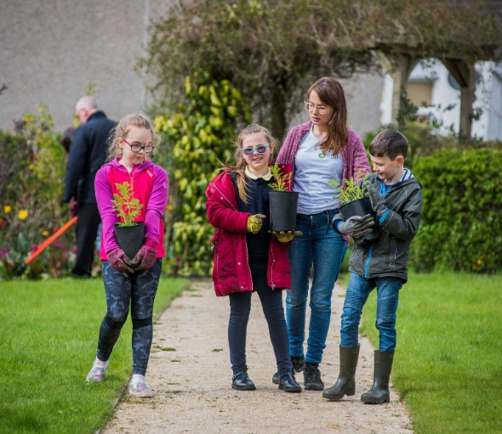
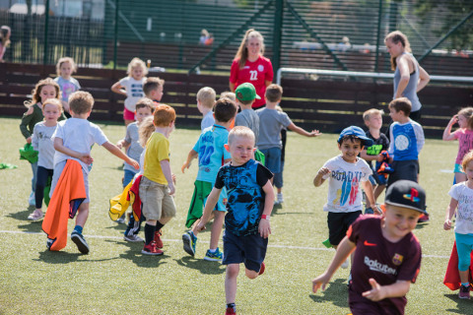
Last year, we supported communities to deliver
1,094
projects
in Scotland using money raised by National Lottery players
Notes:
*2018/2019 financial year figures

Slide 5
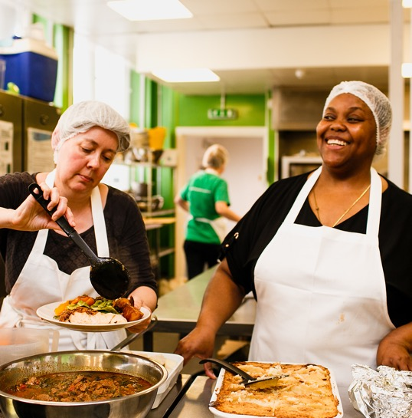
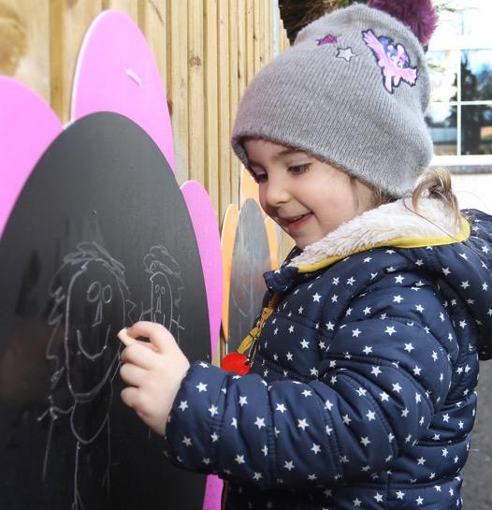
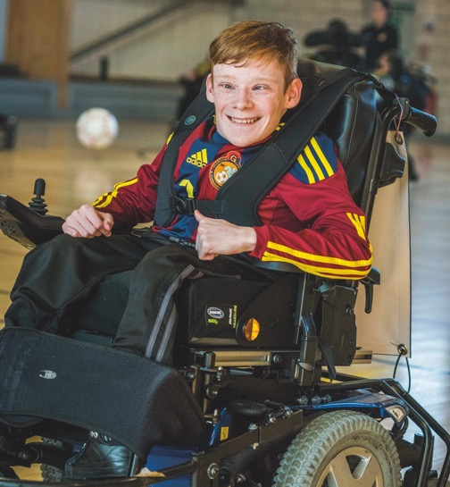
We fund
all sorts
of work

Slide 6
We don’t bite!

Slide 7
What we fund
Notes:
*2018/2019 financial year figures

Slide 8
We want work
we fund to be:
People-led
Strengths-based
Connected

Slide 9
What specific funding is available?

Slide 10
Simple to apply for £300 to £10,000
Very broad: community, sports, arts, events, equipment, promotion, start-up costs and more
Involve your community in planning/delivery!

Slide 11
Using small grants for assets and community work
Quickest way to get money – helps tackle key community priorities and get the ball rolling
Most org types eligible
For assets: don’t need ownership!
Can fund minor purchase or development
Potential for multiple grants for ‘phased’ projects

Slide 12
Community-Led Activity
Up to £150k
To support communities to bring real improvements to the places they live & the wellbeing of those most in need
Mainly activity funding, but can fund up to £50k capital

Slide 13
Community-Led Activity
Max £50k capital
Community led & run orgs only
Based in local area and locally run (not community of interest)
Social purpose
Open membership
Community control (on board)

Slide 14
£10,000-£1Million
For local communities to buy important land or assets
Just purchase, not building work

Slide 15
Current round running till 2020
Stage 2 application deadline set for September 2020
Stage 1 deadline before that (TBC)

Slide 16
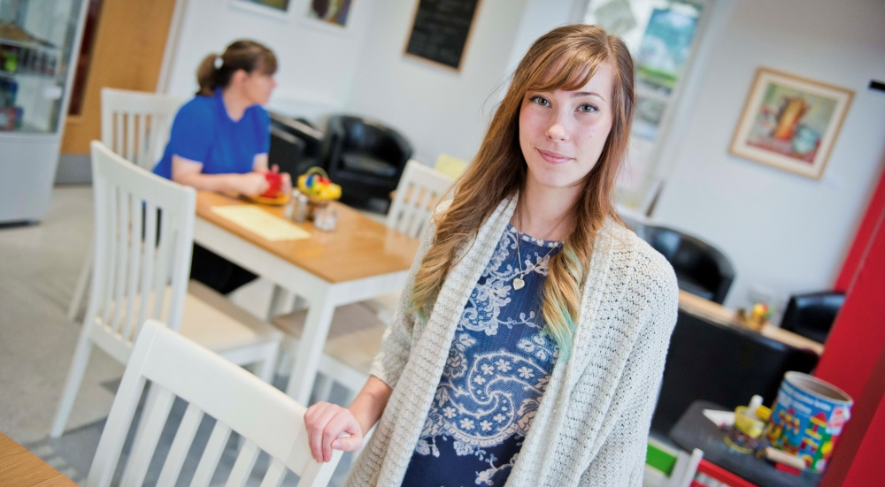
Community Assets
Up to £1m
Purchase, develop and run assets
Asset must address local inequality / disadvantage
Local community must own asset
Org applying must be community run and led
Asset must be sustainable & generate income

Slide 17
Community Assets
Up to £1m
Closure details
Closing to new enquiries 4 October 2019
Final business plans submitted by March 2020
Final decisions in June 2020
No current plans to reopen / replace

Slide 18
Any questions?

Slide 19
What next?
Notes:
*2018/2019 financial year figures

Slide 20
Future of our funding
Most current funds closing in 2020
We’re working out what our new funding offer could look like after 2020
We expect to remain involved in developing community assets in the future…

Slide 21
Future of our funding
…but we need to understand where our limited funding can make the biggest difference

Slide 22
What are the big questions?
What are the big challenges and opportunities for community groups that own assets?
How can funders help with / make the most of these?

Slide 23
1. What are the key future challenges for asset projects?
And what support would help most?

Slide 24
2. What are the big opportunities for assets work?
How can funders help make the most of this?

Slide 25
3. How would you spend:
£25k
£100k
£250k

Slide 26
Any questions?

Slide 27
Keep in touch!
0300 123 7110
advicescotland@tnlcommunityfund.org.uk
@TNLComFundScot facebook.com/TNLCommunityFundScotland www.tnlcommunityfund.org.uk
Bigblogscotland.org.uk

