Slide 1
Using your political representatives

Slide 2
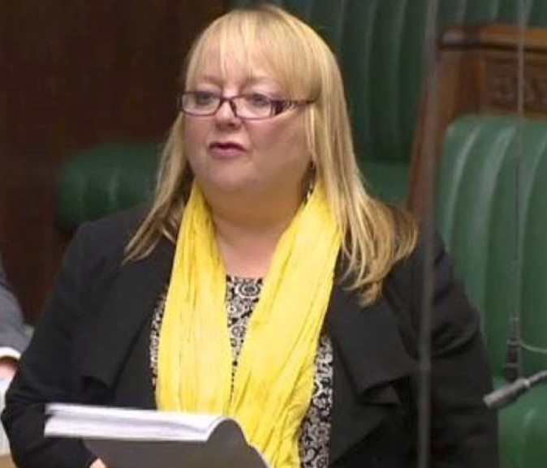
My background – MSP & MP

Slide 3
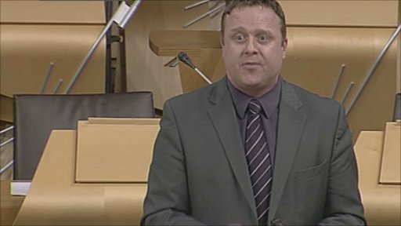
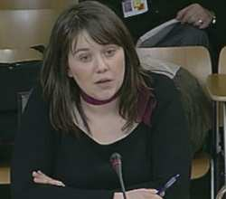
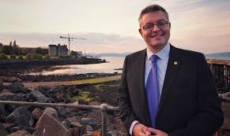
My background – political advisor

Slide 4
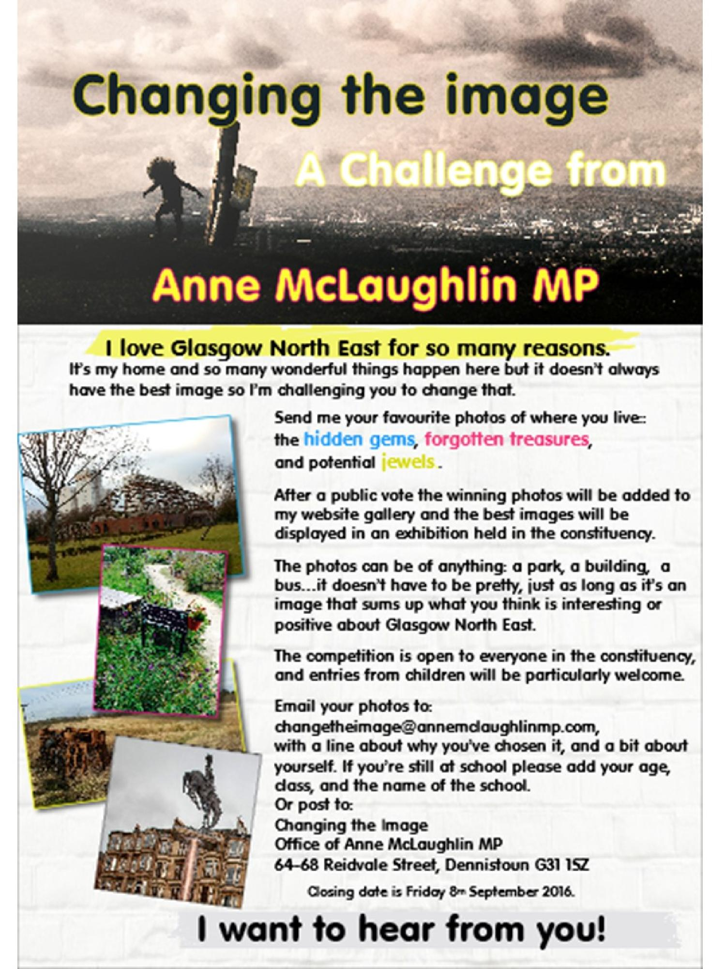
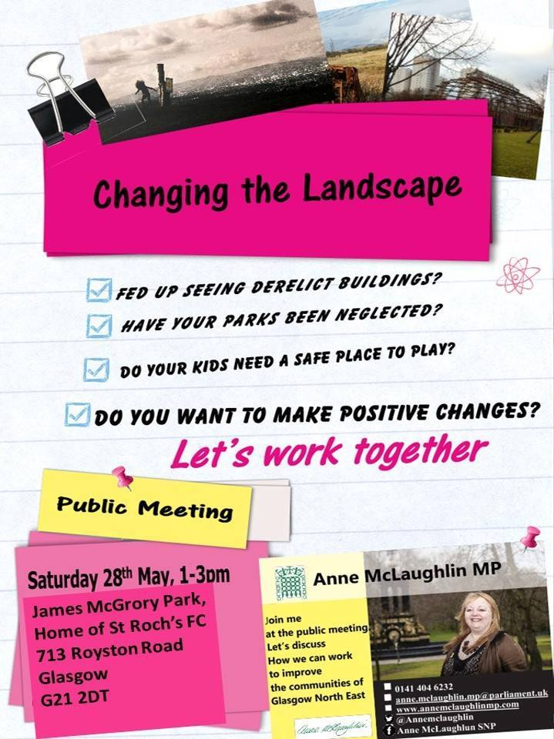
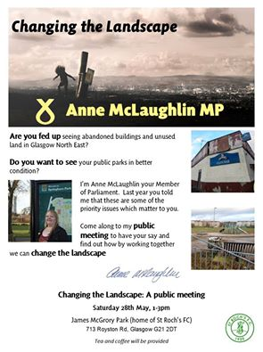
My background – community empowerment

Slide 5
My current …
I deliver workshops and coaching sessions for:
Individuals;
Small groups;
Large audiences in the UK and overseas.
The sessions are in 3 main areas:
Public speaking and crafting speeches and presentations;
Confident Leadership ;
Political engagement.
I also WRITE the speeches and presentations for them and carry out the political engagement but ALWAYS, I am passing on the know how.

Slide 6
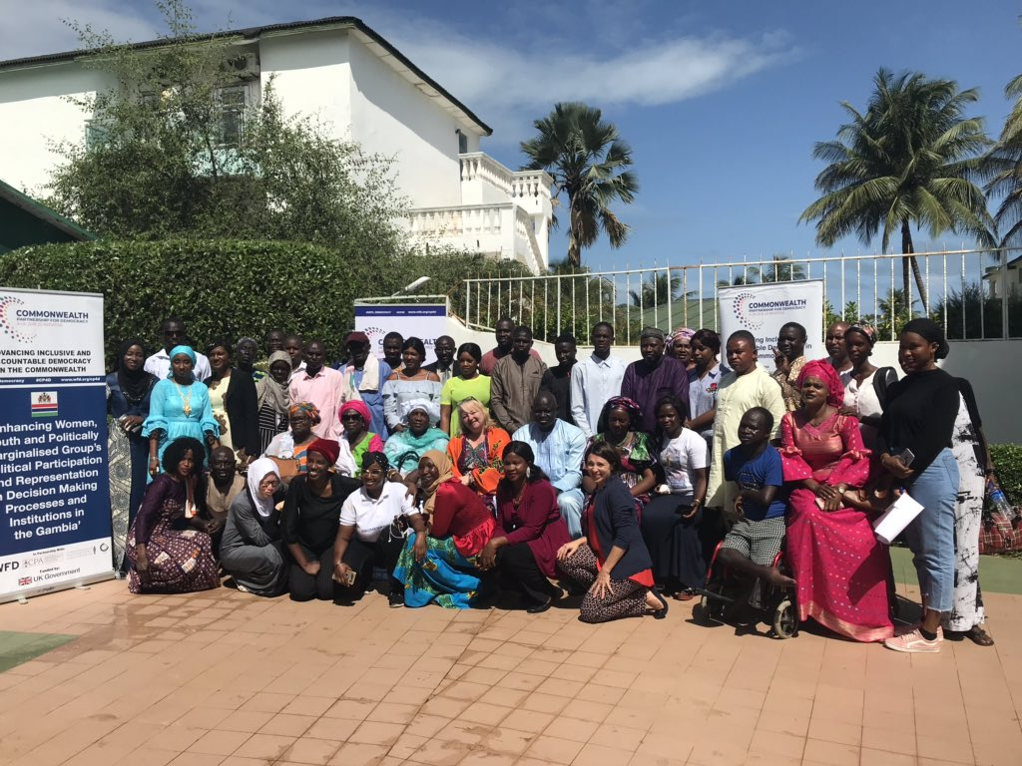
Breadth of experience

Slide 7
A not-so-average-day-in-the-life of an MSP

Slide 8
So if you’re not telling us that (yet) what ARE you telling us Anne???

Slide 9
My aim today …
My aim is to give you a better understanding of how you can get support from your politicians.

Slide 10
3 fundamental questions to answer
How does it benefit us to have the support of politicians?
What’s the most effective way to contact a politician?
In what SPECIFIC ways can they support my organisation?

Slide 11
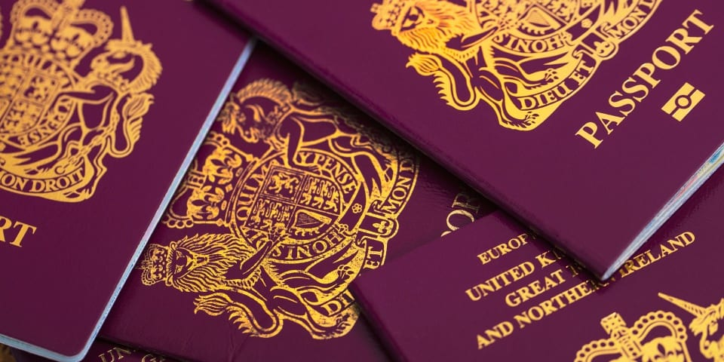
1. How does it benefit us to have the support of politicians?

Slide 12
2. What is the most effective way to contact a politician?
Understanding the competing demands on the time of a politician
Least effective – be vague, CC in emails, take ages to tell them what you actually want, insist you must speak directly to them.
Most effective – target according to constituency but also interest, remind them of their interest, be clear what you want, say it early, do their homework for them, if emailing do it one by one, get to know staff.

Slide 13
3. In what specific ways can they support my organisation?
Ask a supplementary oral question
Next Wednesday
It’s questions to the Government
on Environment, Climate Change and LAND REFORM.
LAND REFORM!!!

Slide 14
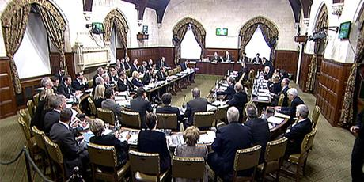
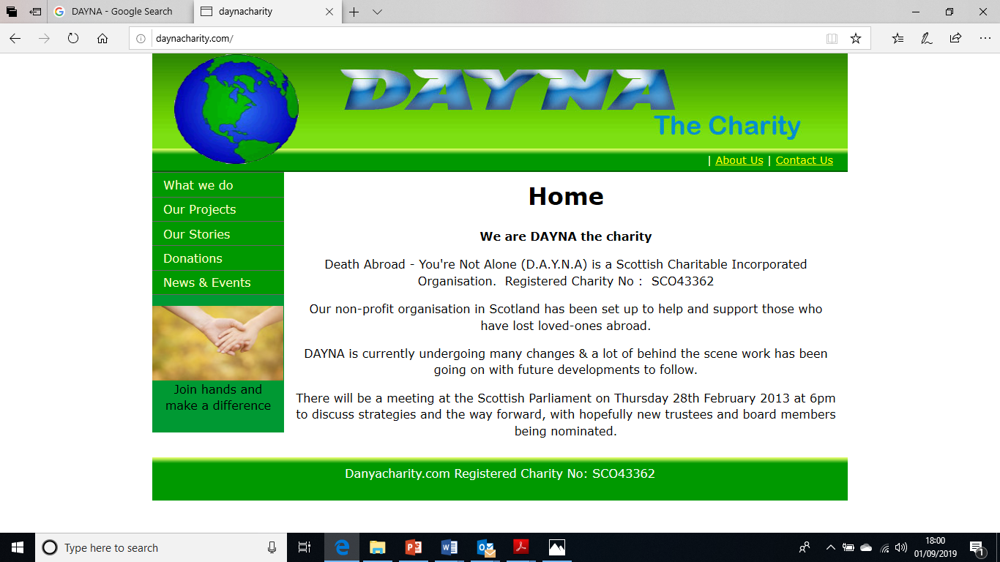
3. In what specific ways can they support my organisation?

Slide 15
Ten things politicians can (and usually will) do to support you
1) Ask Oral Questions of Government Ministers or Council Leaders
2) Ask Supplementaries to Oral Questions
3) Write to Government Ministers and other stakeholders
4) Host meetings, receptions and events in Parliament or Council eg Civic Reception
5) Mention in speeches or when speaking in committee (inc petitions committee)
6) Submit and publish a motion or an EDM
7) Hold a Member’s Debate / Westminster Hall Debate / Adjournment Debate
8) Submit written questions which government ministers must respond to in writing within certain timeframe
9) Attend your events
10) Send out Press Release supporting your campaign – and persuade other Politicians to do so. (Photo booth.)

Slide 16
A not-so-average-day-in-the-life of an MSP

Slide 17
Why did it work?
1. He took my call because I was an MSP.
I had the courage to ask because I was an MSP.
I had an existing relationship with and knowledge of the stress centre – they had kept me informed.

Slide 18
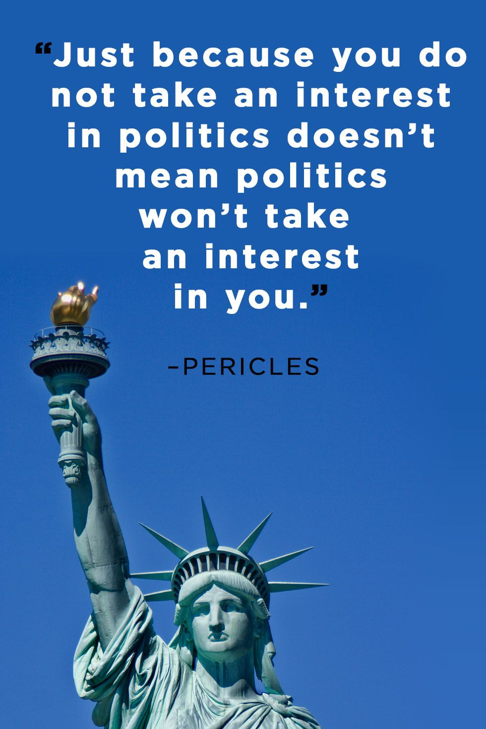
Finally …

