Slide 1
Pat Armstrong
@patacosvo
People.....Place.....Progress
‘
Notes:
.

Slide 2
Who are ACOSVO
‘
Notes:
Pat will give an oversight of opportunities and challenges in the sector from a leadership and governance perspective – and where to find help when you need it. Insights will come from; chairing the third sector governance forum who led on developing the governance code, a sector study which shows differences in the rating of third sector organisations performance by board and staff, and her own perceptions as a third sector leader and the boards she has worked with over the years.

Slide 4
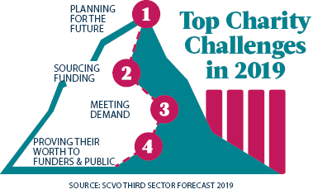

Slide 6
ACOSVO Leadership Lifecycle
Future Leaders
Governance
Leadership Lifecycle
Chief Officers
Next Stage Leaders

Slide 7
The Four Core Capacities Model
The ability of all organisational leaders to create & sustain the vision, inspire, model, prioritize, make decisions, provide direction, & innovate, all in an effort to achieve the organisational mission.
The ability of a charity to monitor, assess, respond to and create internal and external changes.
Adaptive
Leadership
Technical
Management
The ability of a charity to ensure the effective and efficient use of organisational resources.
The ability of a charity to implement all of the key organisational and programmatic functions.

Slide 8
Path to Impact
Lowest:
Leadership Sustainability, Resource Sustainability,
Resource adaptability
Highest:
Environmental Learning, Leader Vision, Managing Staff
Biggest difference:
Re-energising Staff, Organisational learning, board leadership

Slide 9
Governance Forum
Trustee week in Scotland
Governance code
Chairs network
www.goodgovernance.scot

Slide 10
Governance Code
Organisational Purpose
Leadership
Board Behaviour
Control
Effectiveness
‘
Notes:
Pat will give an oversight of opportunities and challenges in the sector from a leadership and governance perspective – and where to find help when you need it. Insights will come from; chairing the third sector governance forum who led on developing the governance code, a sector study which shows differences in the rating of third sector organisations performance by board and staff, and her own perceptions as a third sector leader and the boards she has worked with over the years.

Slide 11
Juggling while riding a unicycle

Slide 12
9 word Job Description
Hold the context
Manage the energy
Coach don’t play
‘
Notes:
.

Slide 13
3 D’s of leadership
Decide
Delegate
Disappear
‘
Notes:
.

Slide 14
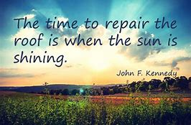

Slide 15
Discount code
DTAS20
‘
Notes:
.

Slide 16
What is ACOSVO?
ACOSVO is focused on excellent third sector leadership. We connect and support over 500 leaders throughout various stages of their leadership journey.

Slide 17
What does ACOSVO offer?
We provide services, networks, and events encouraging the sharing of ideas and best practice in a safe, confidential space.

Slide 18
Events
‘
Notes:
.

Slide 19
ACOSVO Member Benefits
Access to experts in HR, Legal, Governance, Investments, Media, & Marketing
Networks such as Regional, Women’s, Alumni & Chairs
45+ events including masterclasses, dinners, lunches, workshops & conferences
Private LinkedIn members group with access to over 300 third sector leaders

Slide 20
ACOSVO Member Services
Leadership Exchange
Pairs leaders cross sector to share learning & develop
Chief Officer first 100 Days
Offers a support toolkit to new CEO’s
Mentoring Programme
Provides dedicated mentors to support your leadership role

Slide 21
ACOSVO Member Services
Leader Support Service
Provides phone & action plan support to CO’s in crisis
Interim Executive Service
Offers temporary support during leadership transition
Mediation Service
Support leaders in resolving disputes or sensitive issues
360° Appraisal
Offers leader behaviour & performance feedback from others

